Slide 1
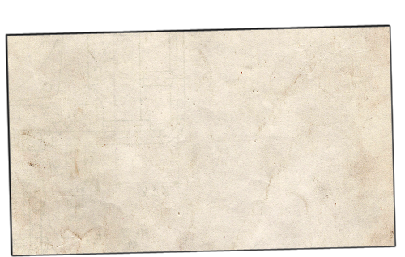

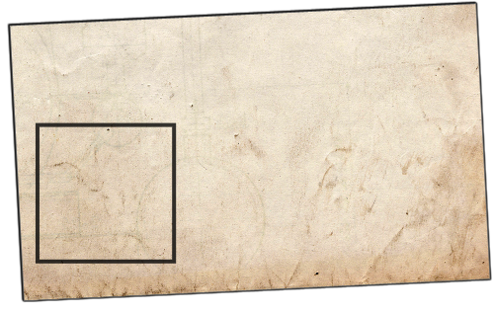










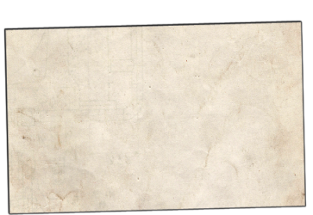



Bobby
Health 4/6
Composure 3/3
Armor Class 12
Healthy
65% Chance to hit
End Turn (Q)
1. Bobby
2. Johnny
3. Jennifer
4. Clarence
5. Marauder
6. Clarence Jr.
Welcome to Bel Nix!

Slide 2

Bobby
Health 4/6
Composure 3/3
Armor Class 12
Healthy
Move and Attack
Move and Throw
Move and Intim.
Examine
65%
70%
50%
70%
*click*
End Turn (Q)
1. Bobby
2. Johnny
3. Jennifer
4. Clarence
5. Marauder
6. Clarence Jr.
Welcome to Bel Nix!

Slide 3
Bobby
Health 4/6
Composure 3/3
Armor Class 12
Healthy
Move and Attack
Move and Throw
Move and Intim.
Examine
65%
70%
50%
70%
End Turn (Q)
1. Bobby
2. Johnny
3. Jennifer
4. Clarence
5. Marauder
6. Clarence Jr.
Welcome to Bel Nix!

Slide 4
Bobby
Health 4/6
Composure 3/3
Armor Class 12
*click*
End Turn (Q)
1. Bobby
2. Johnny
3. Jennifer
4. Clarence
5. Marauder
6. Clarence Jr.
Welcome to Bel Nix!

Slide 5

Bobby
Health 4/6
Composure 3/3
Armor Class 12
Move
*click*
End Turn (Q)
1. Bobby
2. Johnny
3. Jennifer
4. Clarence
5. Marauder
6. Clarence Jr.
Welcome to Bel Nix!

Slide 6
Bobby
Health 4/6
Composure 3/3
Armor Class 12
Move
*click*
End Turn (Q)
1. Bobby
2. Johnny
3. Jennifer
4. Clarence
5. Marauder
6. Clarence Jr.
Welcome to Bel Nix!

Slide 7
Bobby
Health 4/6
Composure 3/3
Armor Class 12
Confirm
Move
*click*
End Turn (Q)
1. Bobby
2. Johnny
3. Jennifer
4. Clarence
5. Marauder
6. Clarence Jr.
Welcome to Bel Nix!

Slide 8
Bobby
Health 4/6
Composure 3/3
Armor Class 12
End Turn (Q)
1. Bobby
2. Johnny
3. Jennifer
4. Clarence
5. Marauder
6. Clarence Jr.
Welcome to Bel Nix!

Slide 9
Bobby
Health 4/6
Composure 3/3
Armor Class 12
End Turn (Q)
*click*
1. Bobby
2. Johnny
3. Jennifer
4. Clarence
5. Marauder
6. Clarence Jr.
Welcome to Bel Nix!

Slide 10


Bobby
Health 4/6
Composure 3/3
Armor Class 12
End Turn (Q)
*click*
1. Bobby
2. Johnny
3. Jennifer
Welcome to Bel Nix!

Slide 11
Bobby
Health 4/6
Composure 3/3
Armor Class 12
End Turn (Q)
*click*
1. Bobby
2. Johnny
3. Jennifer
Welcome to Bel Nix!

Slide 12
Bobby
Health 4/6
Composure 3/3
Armor Class 12
End Turn (Q)
1. Bobby
2. Johnny
3. Jennifer
*click*

Slide 13
Bobby
Health 4/6
Composure 3/3
Armor Class 12
End Turn (Q)
1. Bobby
2. Johnny
3. Jennifer
*click*

Slide 14
Bobby
Health 4/6
Composure 3/3
Armor Class 12
End Turn (Q)
1. Bobby
2. Johnny
3. Jennifer
*click*

Slide 15
Bobby
Health 4/6
Composure 3/3
Armor Class 12
Healthy
65% Chance to hit
End Turn (Q)
1. Bobby
2. Johnny
3. Jennifer
Welcome to Bel Nix!

Slide 16
Bobby
Health 4/6
Composure 3/3
Armor Class 12
Healthy
Attack
Throw
Intimidate
Examine
65%
70%
50%
70%
*click*
End Turn (Q)
1. Bobby
2. Johnny
3. Jennifer
Welcome to Bel Nix!

Slide 17
Bobby
Health 4/6
Composure 3/3
Armor Class 12
Healthy
Attack
Throw
Intimidate
Examine
65%
70%
50%
70%
*click*
End Turn (Q)
1. Bobby
2. Johnny
3. Jennifer
Welcome to Bel Nix!

Slide 18
Bobby
Health 4/6
Composure 3/3
Armor Class 12
Healthy
Attack
Throw
Intimidate
Examine
65%
70%
50%
70%
Confirm
*click*
End Turn (Q)
1. Bobby
2. Johnny
3. Jennifer
Welcome to Bel Nix!

Slide 19
Bobby
*click*
Health 4/6
Composure 3/3
Armor Class 12
Character Sheet of person you examined
Attack
Throw
Intimidate
*right-click*
End Turn (Q)
1. Bobby
2. Johnny
3. Jennifer
Welcome to Bel Nix!

Slide 20
Bobby
Health 4/6
Composure 3/3
Armor Class 12
Healthy
65% Chance to hit
*right-click*
End Turn (Q)
1. Bobby
2. Johnny
3. Jennifer
Welcome to Bel Nix!

Slide 21
Johnny
Health 6/7
Composure 2/2
Armor Class 13
End Turn (Q)
1. Johnny
2. Jennifer
3. Clarence
Welcome to Bel Nix!
Bobby attacked Marauder for 2 damage!
Johnny’s Turn!

